Slide 1
TCP/IP Protocol Suite and IP Addressing
Kiptoo S

Slide 2
Communication Architecture
OSI Model
Strategy for connecting host computers and other communicating equipment.
Defines necessary elements for data communication between devices.
A communication architecture, therefore, defines a standard for the communicating hosts.
A programmer formats data in a manner defined by the communication architecture and passes it on to the communication software.
Separating communication functions adds flexibility, for example, we do not need to modify the entire host software to include more communication devices.

Slide 3
Layer Architecture
OSI Model
Layer architecture simplifies the network design.
It is easy to debug network applications in a layered architecture network.
The network management is easier due to the layered architecture.
Network layers follow a set of rules, called protocol.
The protocol defines the format of the data being exchanged, and the control and timing for the handshake between layers.

Slide 4
Open Systems Interconnection (OSI) Model
OSI Model
International standard organization (ISO) established a committee in 1977 to develop an architecture for computer communication.
Open Systems Interconnection (OSI) reference model is the result of this effort.
In 1984, the Open Systems Interconnection (OSI) reference model was approved as an international standard for communications architecture.
Term “open” denotes the ability to connect any two systems which conform to the reference model and associated standards.

Slide 5
OSI Reference Model
OSI Model
The OSI model is now considered the primary Architectural model for inter-computer communications.
The OSI model describes how information or data makes its way from application programmes (such as spreadsheets) through a network medium (such as wire) to another application programme located on another network.
The OSI reference model divides the problem of moving information between computers over a network medium into SEVEN smaller and more manageable problems .
This separation into smaller more manageable functions is known as layering.

Slide 6
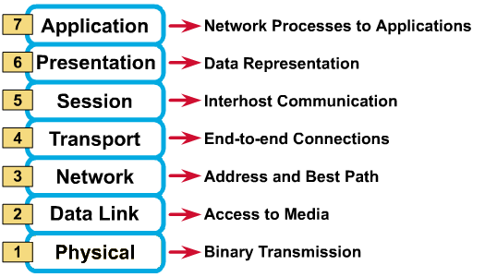
OSI Reference Model: 7 Layers
OSI Model

Slide 7
Introduction to TCP/IP
The U.S. DoD created the TCP/IP reference model because it wanted a network that could survive any conditions.
TCP/IP model has become the Internet standard.

Slide 8
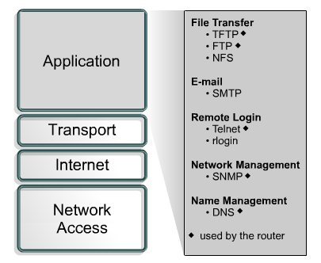
Application Layer
Handles high-level protocols, issues of representation, encoding, and dialog control.

Slide 9
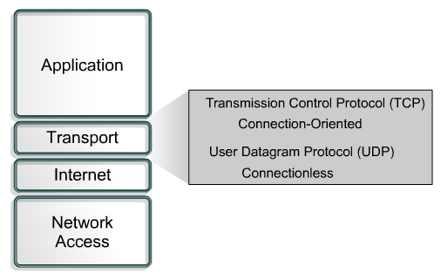
Transport Layer
Five basic services:
Segmenting upper-layer application data
Establishing end-to-end operations
Sending segments from one end host to another end host
Ensuring data reliability
Providing flow control

Slide 10
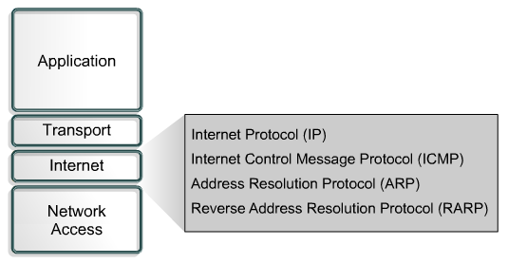
Internet Layer
Best path determination and packet switching

Slide 11
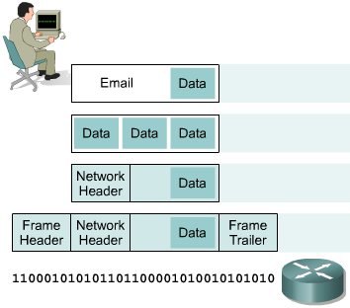
IP as a Routed Protocol
IP is a connectionless, unreliable, best-effort delivery protocol.
As information flows down the layers of the OSI model; the data is processed at each layer.
IP accepts whatever data is passed down to it from the upper layers.

Slide 12
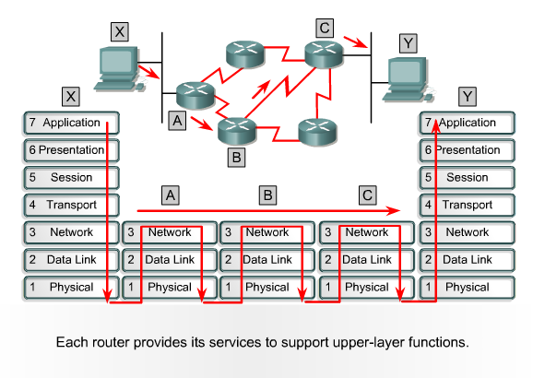
Packet Propagation and Switching Within a Router

Slide 13
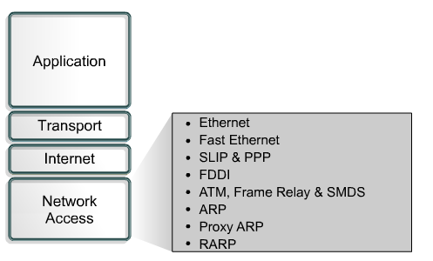
Network Access Layer
The network access layer is concerned with all of the issues that an IP packet requires to actually make a physical link to the network media.
It includes the LAN and WAN technology details, and all the details contained in the OSI physical and data link layers.

Slide 14
IPv4 Addressing Overview
Internet address’s architecture
Classes of IP addresses
Subnet mask

Slide 15
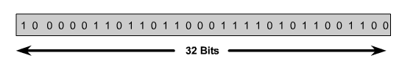

IP Address
An IP address is a 32-bit sequence of 1s and 0s.
To make the IP address easier to use, the address is usually written as four decimal numbers separated by periods.
This way of writing the address is called the dotted decimal format.

Slide 16
Every IP address has two parts:
Network
Host
IP addresses are divided into classes A,B and C to define large, medium, and small networks.
The Class D address class was created to enable multicasting.
IETF reserves Class E addresses for its own research.

Slide 17
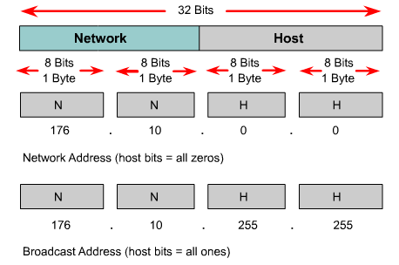
Reserved IP Addresses
Certain host addresses are reserved and cannot be assigned to devices on a network.
An IP address that has binary 0s in all host bit positions is reserved for the network address.
An IP address that has binary 1s in all host bit positions is reserved for the broadcast address.

Slide 18
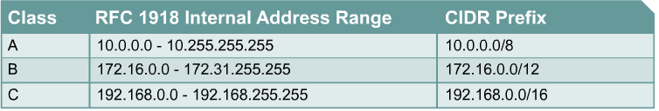
IP Private Addresses
No two machines that connect to a public network can have the same IP address because public IP addresses are global and standardized
Private IP addresses are a solution to the problem of the exhaustion of public IP addresses. Addresses that fall within these ranges are not routed on the Internet backbone:
Connecting a network using private addresses to the Internet requires the usage of NAT

Slide 19
Subnet Mask Address
Determines which part of an IP address is the network field and which part is the host field.
Follow these steps to determine the subnet mask:
1. Express the subnetwork IP address in binary form.
2. Replace the network and subnet portion of the address with all 1s.
3. Replace the host portion of the address with all 0s.
4. Convert the binary expression back to dotted-decimal notation.

Slide 20
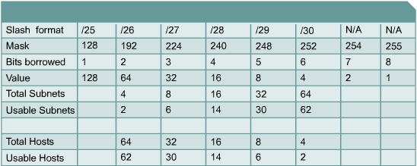
Establishing the Subnet Mask Address
To determine the number of bits to be used, the network designer needs to calculate how many hosts the largest subnetwork requires and the number of subnetworks needed.

Slide 21
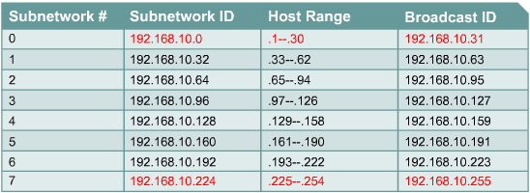
Subnetting example

Slide 22
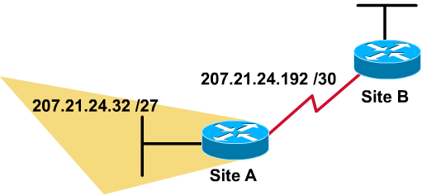
Variable-Length Subnet Mask - VLSM
VLSM allows you to use more than one subnet mask within the same network address space - subnetting a subnet
S | Subnet Add
0 | 207.21.24.0/27
1 | 207.21.24.32/27
2 | 207.21.24.64/27
3 | 207.21.24.96/27
4 | 207.21.24.128/27
5 | 207.21.24.160/27
6 | 207.21.24.192/27
7 | 207.21.24.224/27
Sub-sub | Sub-Subnet Add
Sub 0 | 207.21.24.192/30
Sub 1 | 207.21.24.196/30
……..
Sub 5 | 207.21.24.212/30
Sub 6 | 207.21.24.216/30
Sub 7 | 207.21.24.220/30

Slide 23
Supernetting
Using a bitmask to group multiple classful networks as a single network address.
Same process with route aggregation.
supernetting is most often applied when the aggregated networks are under common administrative control.
In class C network addresses, supernetting can be used so that the addresses appear as a single large network, or supernet

Slide 24
Questions?

